Slide 1


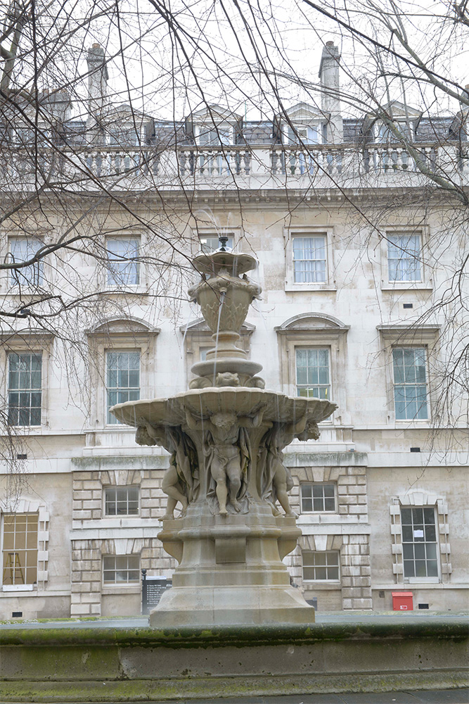

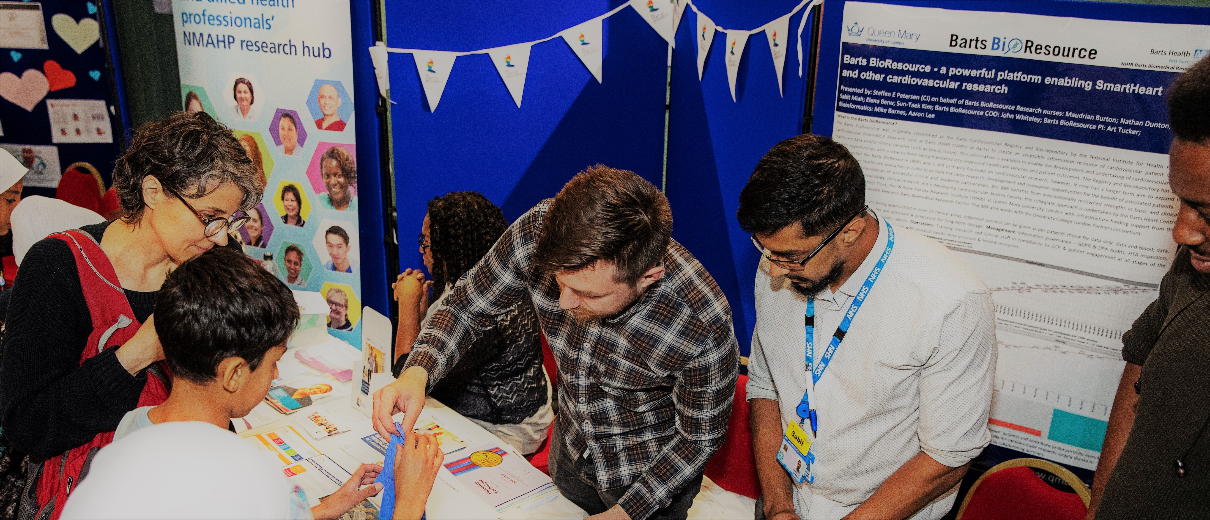
Who we are…
..an establish bioresource of participants who consent to participate and donate blood, saliva, urine and tissue samples.
The research we do..
This will be used for cardiovascular and other disease based research opportunities which will be translated back into improving health care…”
Helping science for the future
Trying new treatments
Hope
Benefit others in the future
Improving lifestyle
What does Research means for young people?
Who we need
We need volunteers who are having a clinical procedure at Bars Health.
For further information, please contact contact.bartsbioresource@qmul.ac.uk.

