Slide 1


Acquisition
Learning through acquisition is what learners are doing when they are listening to a lecture or podcast, reading from books or websites, and watching demos or videos
Adapted from ABC Learning Design method Clive Young and Natasa Perovic, UCL.

Slide 2
Collaboration
Learning through collaboration embraces mainly discussion, practice, and production.
Building on investigations and acquisition it is about taking part in the process of knowledge building itself
Adapted from ABC Learning Design method Clive Young and Natasa Perovic, UCL.

Slide 3
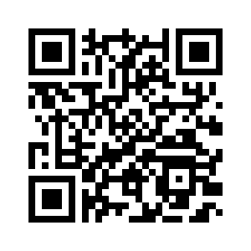
Acquisition
Reading books, papers;
Conventional method
Digital technology
Reading books, papers
Reading digital documents and resources via QMplus books, pages, files, Talis online reading lists.
Listening to teacher presentations face-to-face, lectures
Learning from interactive content via H5P, interactive content tools on QMplus.
Watching demonstrations, master classes
Watching animations, videos, lecture recordings via QMplus Media, Q-Review, Box of Broadcasts.
Add your own…
Add your own…
Guides are available at https://elearning.qmul.ac.uk/tag/acquisition/

Slide 4
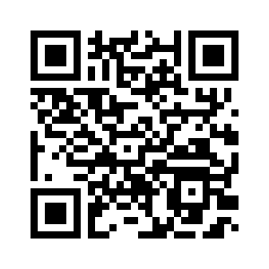
Collaboration
Reading books, papers;
Digital technology
Conventional method
Small group project.
Small group projects using QMplus Hub groups, QMplus forums, QMplus wiki
Discussing others’ outputs.
Building joint output.
Building joint digital outputs using QMplus databases, glossaries, wikis, blogs, QMplus Hub pages and collections, Turnitin Peermark, creating videos on QMplus Media
Add your own…
Add your own…
Guides are available at https://elearning.qmul.ac.uk/tag/collaboration/

Slide 5
Discussion
Learning through discussion requires the learner to articulate their ideas and questions, and to challenge and respond to the ideas and questions from the teacher,
and/or from their peers
Adapted from ABC Learning Design method Clive Young and Natasa Perovic, UCL.

Slide 6
Investigation
Learning through investigation guides the learner to explore, compare and critique the texts, documents and resources that reflect the concepts and ideas being taught
Adapted from ABC Learning Design method Clive Young and Natasa Perovic, UCL.

Slide 7
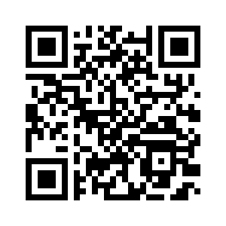
Discussion
Reading books, papers;
Conventional method
Digital technology
Tutorials.
Seminars.
Discussion groups.
Class discussions.
Online tutorials, seminars with Blackboard Collaborate.
Synchronous chats via QMplus Chat.
Asynchronous discussion via QMplus forums, Q-Review question and answer, QMplus Media commenting, QMplus Hub forums, Emails.
Student presentations & discussion with Blackboard Collaborate, TurningPoint, Mentimeter.
Add your own…
Add your own…
Guides are available at https://elearning.qmul.ac.uk/tag/discussion/

Slide 8
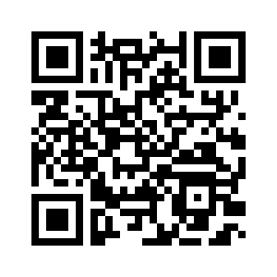
Investigation
in a range of materials and resources;
Using conventional methods to collect
Coparing texts, searching and evaluating information and ideas.
Conventional method
Digital technology
Using text-based study guides
Analysing and ideas and information gathered via QMplus database or glossary.
Analysing the ideas and information in a range of materials and resources
Comparing digital texts in QMplus forum, Peermark, QMplus Hub pages.
Using conventional methods to collect and analyse data
Asking questions via QMplus Forums.
Comparing texts
Reflecting via QMplus Hub Journal, Q-Review captures, QMplus Media Quizzes.
Searching and evaluating information and ideas
Add your own…
Add your own…
Guides are available at https://elearning.qmul.ac.uk/tag/investigation/

Slide 9
Practice
Learning through practice enables the learner to adapt their actions to the task goal, and use the feedback to improve their next action. Feedback may come from self-reflection, from peers, from the teacher, or from the activity itself, if it shows them how to improve the result of their action in relation to the goal
Adapted from ABC Learning Design method Clive Young and Natasa Perovic, UCL.

Slide 10
Production
Learning through production is the way the teacher motivates the learner to consolidate what they have learned by articulating their current conceptual understanding and how they used it in practice
Adapted from ABC Learning Design method Clive Young and Natasa Perovic, UCL.

Slide 11
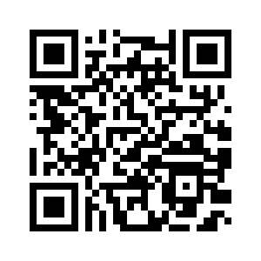
Practice
Reading books, papers;
Conventional method
Digital technology
Practising exercises.
Doing practice-based projects.
Labs.
Field trips.
Face-to-face role-play activities.
Online tests using QMplus quizzes, H5P interactive content, WiseFlow
Virtual labs and models using content created with Articulate or H5P interactive content
Virtual field trips with embedded H5P interactive content, QMplus Media videos..
Online presentations by students using QMplus Media, Blackboard Collaborate.
Assessments via Turnitin.
Add your own…
Add your own…
Guides are available at https://elearning.qmul.ac.uk/tag/practice/

Slide 12
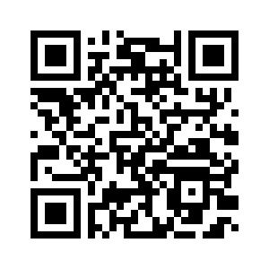
Production
Reading books, papers;
Conventional method
Digital technology
producing articulations using:
statements.
essays.
reports.
accounts.
designs.
performances.
artefacts.
animations.
models.
videos.
Producing shared digital documents in QMplus discussion forums, QMplus Hub Pages.
Performances captured on video and shared via Q-Review, QMplus Media
Final assessments submitted via QMplus Assignments, Turnitin, WiseFlow.
Images, videos, animations, other artefacts shared in databases, glossaries, QMplus Media. QMplus Hub pages
E-portfolios using QMplus Hub.
Add your own…
Add your own…
Guides are available at https://elearning.qmul.ac.uk/tag/production/

