Slide 1
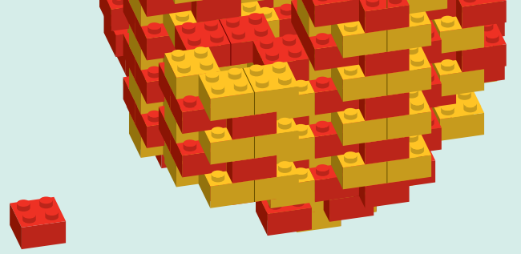
FISSION AND FUSION

Slide 2
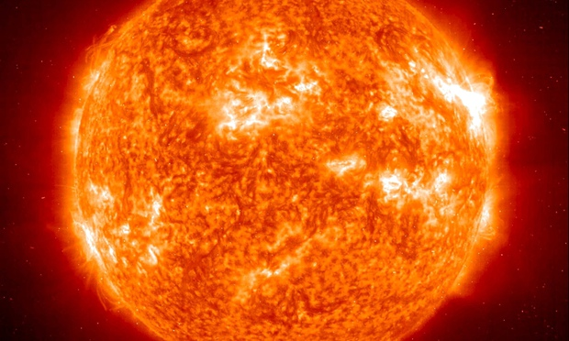
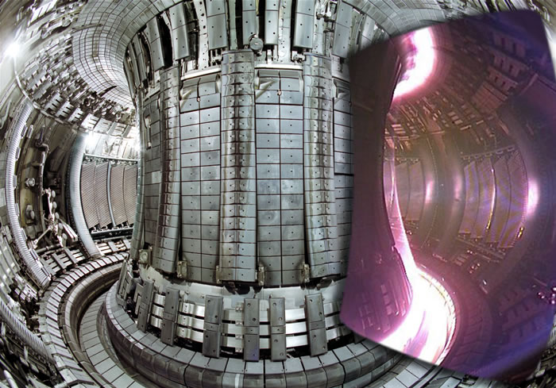
SESSION INTRODUCTION
Nuclear fusion powers the Sun (left) and could be a source of energy in the future (right).
Images courtesy of EPA/Corbis/NASA and EFDA-JET.

Slide 3

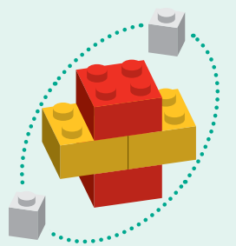

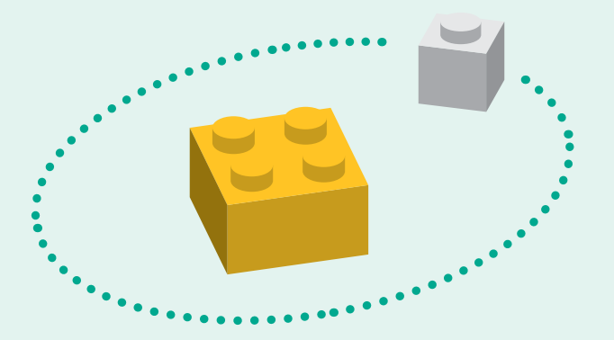
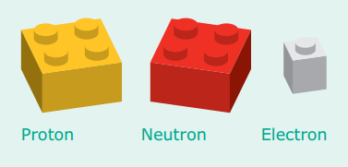
ATOMIC STRUCTURE
Helium atom
Hydrogen atom
If an atom were blown up to the size of Wembley Stadium, its nucleus would only be the size of marble!
Images courtesy of Wikipedia

Slide 4
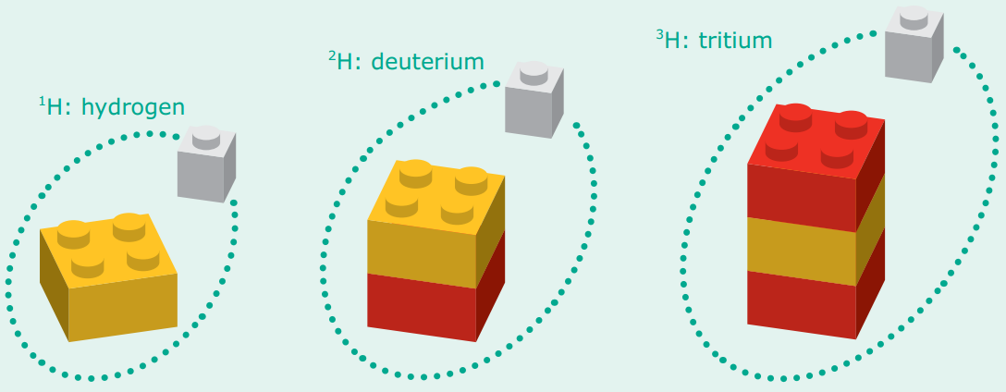
ISOTOPES
Percentage of all Hydrogen atoms occurring naturally
99.9885%
0.0115%
Very Rare

Slide 5
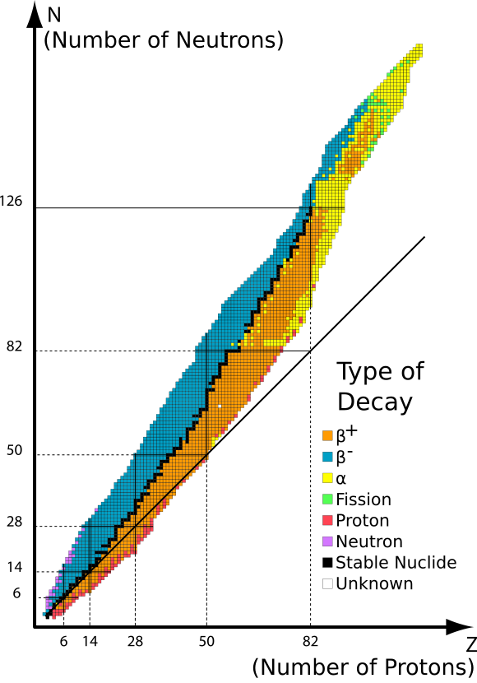




RADIOACTIVITY
Some combinations of Protons and Neutrons are unstable (right), but can become stable through radioactive decay emitting one of these particles:
Alpha Particle
(Helium nucleus)
Beta Minus Particle
(electron)
Beta Plus Particle
(positron)
Gamma Ray
(photon)
The number of protons and neutrons determines which type of decay happens
Image courtesy of Wikipedia

Slide 6
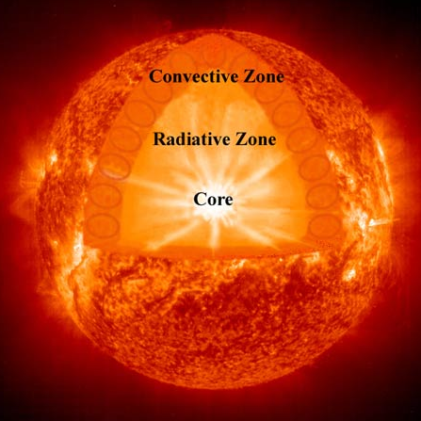
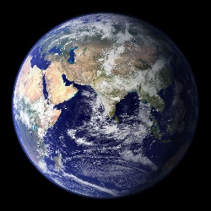
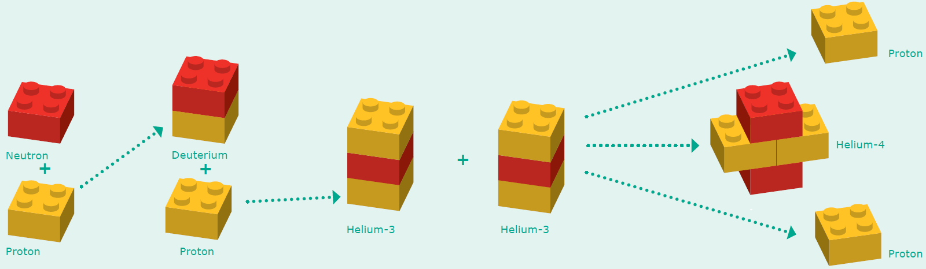
NUCLEAR FUSION
Fusion occurs in the Sun’s core. The light it produces takes 5,000 years to reach the surface and then a further 8 minutes to get to us.
Images courtesy of NASA/SOHO

Slide 7
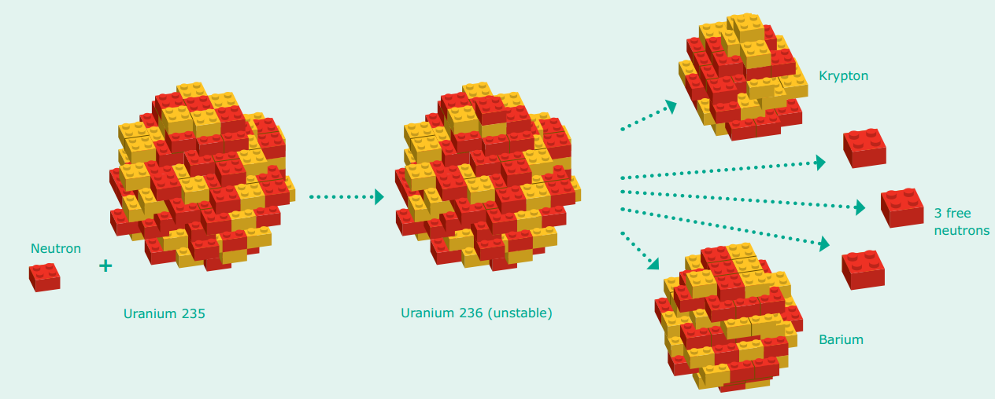
NUCLEAR FISSION
36 protons, 56 neutrons
92 protons, 143 neutrons
92 protons, 144 neutrons
56 protons, 85 neutrons
Neutron captured in Uranium-235 nucleus
Unstable nucleus breaks apart (fissures) to become stable. This is just one way it can split.

Slide 8
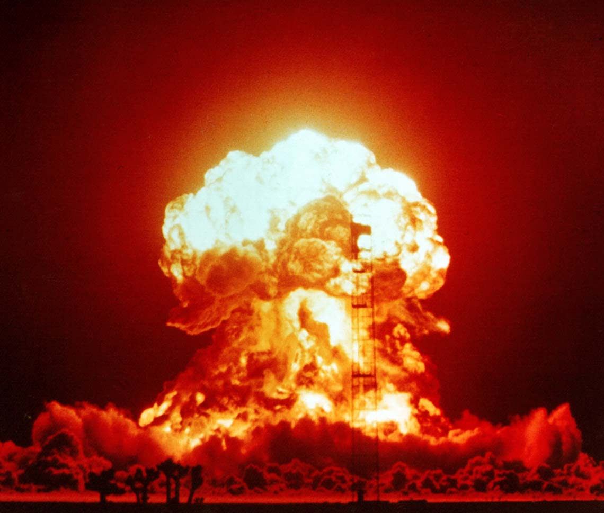
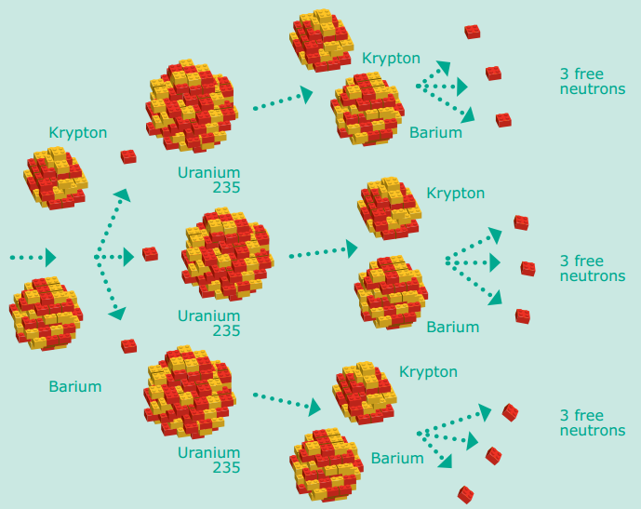
CHAIN REACTIONS
Nuclear weapons rely on runaway chain reactions. The first atomic bombs used fission chain reactions (like that on the left) whereas in modern atomic weapons energy is released though both fission and fusion.
Image courtesy of National Nuclear Security Administration

Slide 9

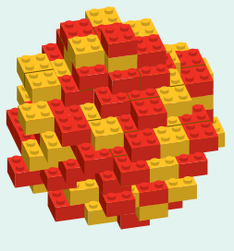
ROUNDUP
Atomic nuclei are formed of protons and neutrons
Isotopes of an element contain different numbers of neutrons
Unstable nuclei undergo radioactive decay (alpha, beta, gamma)
Fusion in the Sun combines protons forming Helium + lots of energy
Fission splits heavy nuclei into lighter elements
This can lead to a chain reaction of nuclear fission

