Slide 1
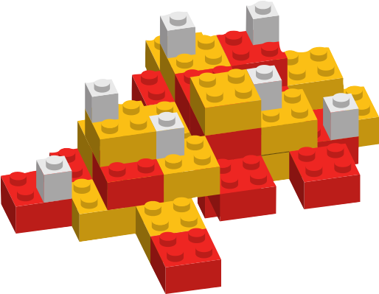
BUILD YOUR OWN UNIVERSE

Slide 2
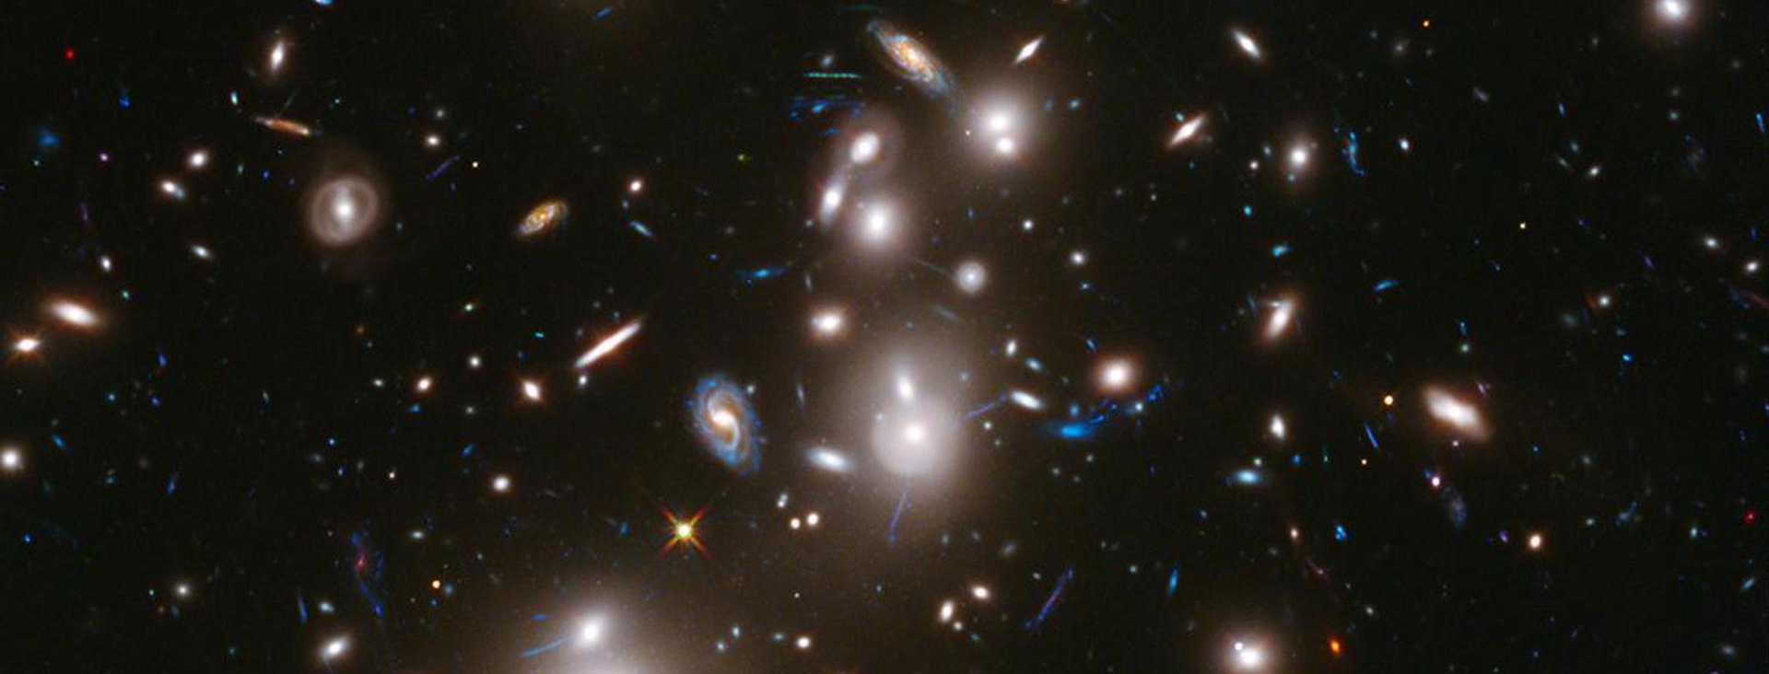
SESSION INTRODUCTION
Hubble Space Telescope image of a cluster of galaxies. Some appear as they did 12 billion years ago.
Image courtesy of NASA/ESA/STScI.

Slide 3






THE FIRST FEW SECONDS
T = >100,000,000,000ºC
Fundamental Particles
down quark
up quark
electron
photon
positron
neutrino
found in threes, make up the matter around us
carry electric charge in circuits
particle of light
antimatter partner of
the electron
interact very little with normal matter

Slide 4


THE FIRST FEW SECONDS
T = 3,000,000,000ºC
up quark
up quark
down quark
proton
down quark
down quark
up quark
neutron

Slide 5


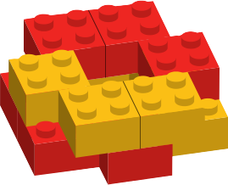
THE FIRST TWO ELEMENTS
2
He
1
H
…to make deuterium
4.0026
1.01
…to make helium -3
add another helium-3…
proton becomes a neutron: beta decay
add another proton…
add a proton to the new neutron…
…to make helium-4 + two extra protons

Slide 6
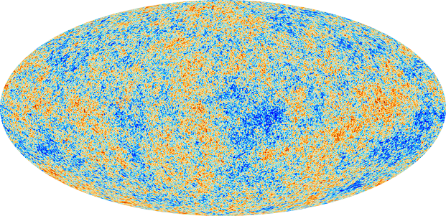
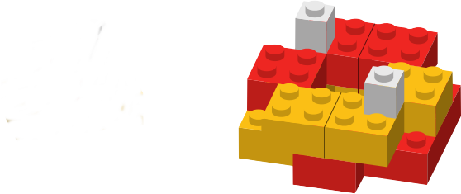

THE BIRTH OF NEUTRAL ATOMS
charge = +1
charge = -1
Cosmic background radiation imaged by the Planck satellite. Image courtesy of ESA/NASA
overall charge = 0
overall charge = 0

Slide 7
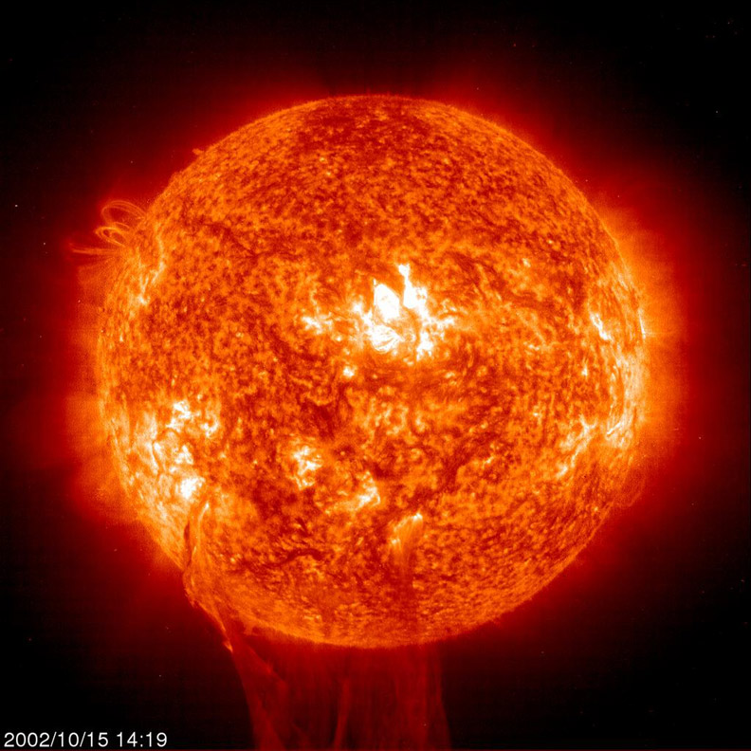
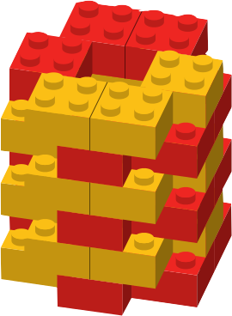
TIME = 100 MILLION YEARS
Elements heavier than helium are made by fusion in the heart of stars. Image courtesy of ESA.

Slide 8
THE END

