Slide 1
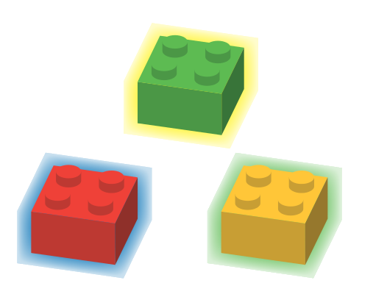
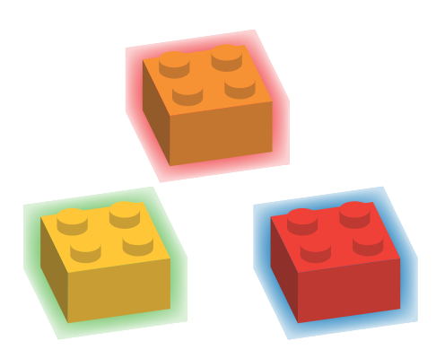
PARTICLE PHYSICS

Slide 2
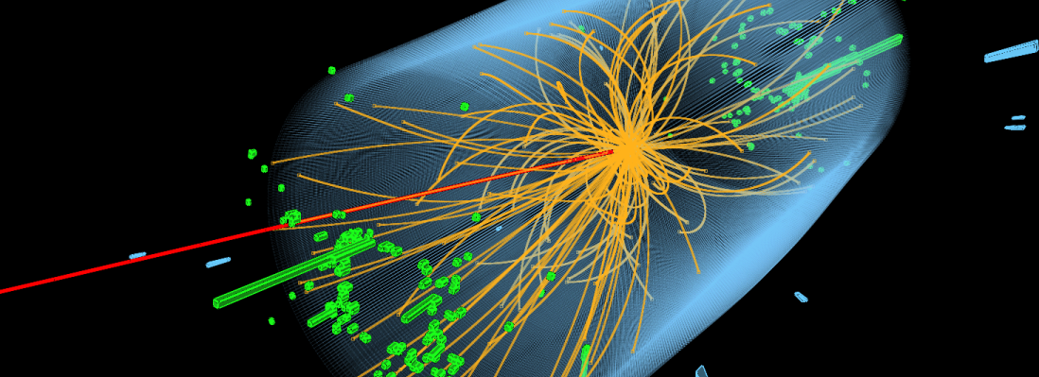
INTRODUCTION
The recorded tracks of sub atomic particles resulting from the collision of two protons in the ATLAS experiment at the Large Hadron Collider at CERN. Image courtesy of CERN.

Slide 3
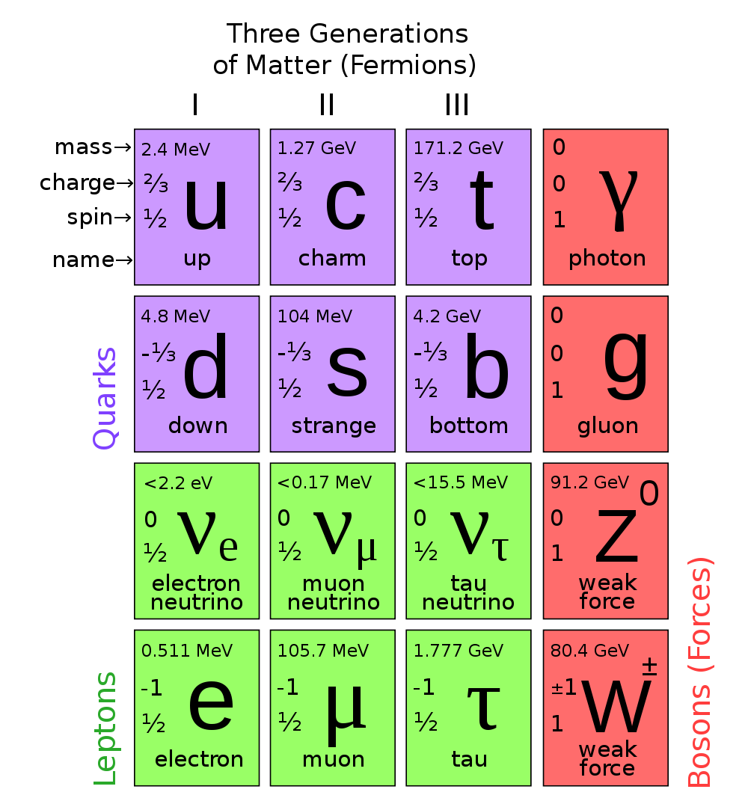



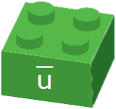
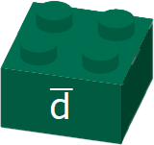

THE SMALLEST THINGS
Up quark
Charge +2/3
Down quark
Charge -1/3
Strange quark
Charge -1/3
Above: The Standard Model of particle physics showing all six quarks with leptons (electron-like particles) and bosons (force carriers). Image courtesy of CERN.
Left: Three of the six quarks with their antiparticles
Antiup quark
Charge -2/3
Antidown quark
Charge +1/3
Antistrange quark +1/3

Slide 4
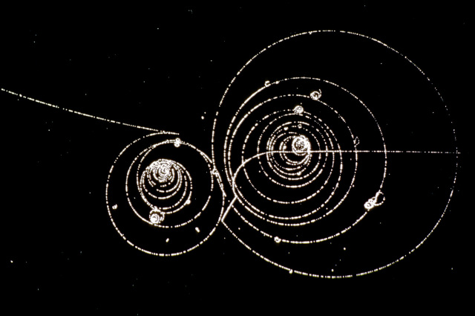
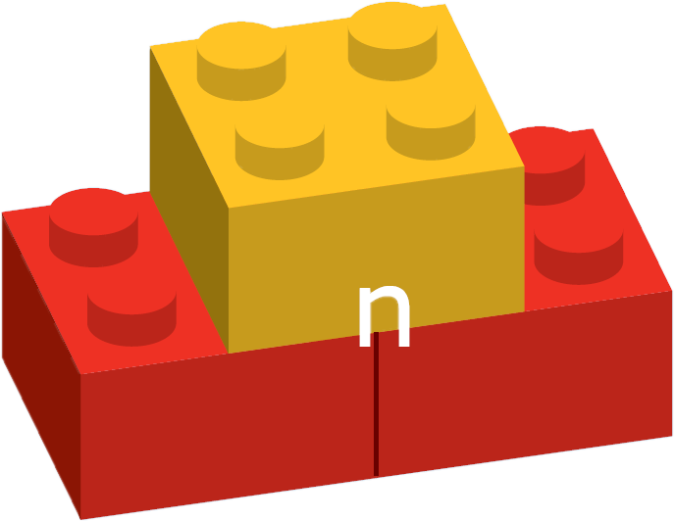
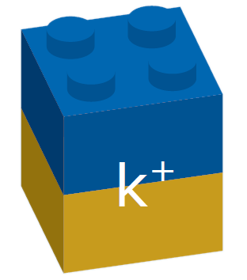
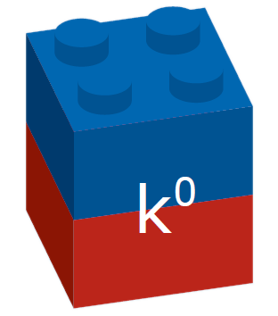
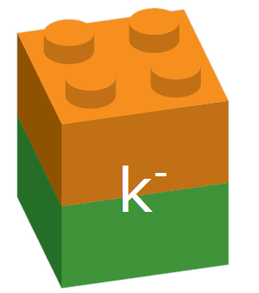
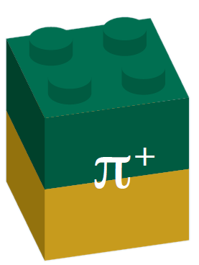
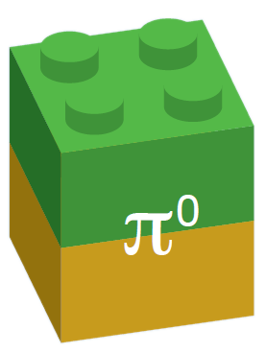
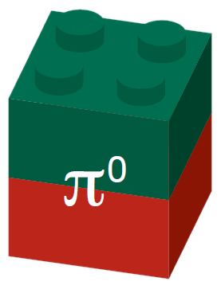
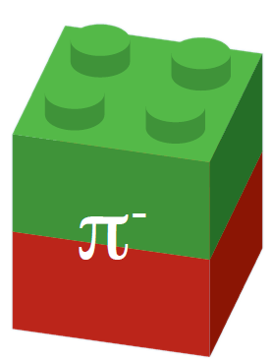
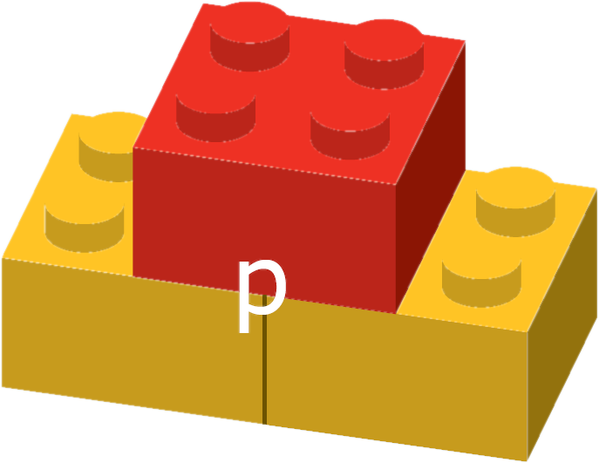
SLIGHTLY BIGGER THINGS
Baryons
Mesons
Neutron
Kaons
Above: A bubble chamber image showing the decay of a moving K+ meson (image left) into other charged particles. The charged decay products are shown spiralling in the chamber’s applied magnetic field.
Image courtesy of CERN.
Proton
Pions

Slide 5



RULES FOR COMBINATION: ELECTRIC CHARGE
The electrical charge of individual quarks has to add up to a whole number. Particles cannot have fractional charge.
Charge 0
Charge +1
Charge -1/3
Charge -2/3
Charge +2/3
Charge -1/3
X
Charge +1/3
Charge +1/3
Charge +1/3

Slide 6
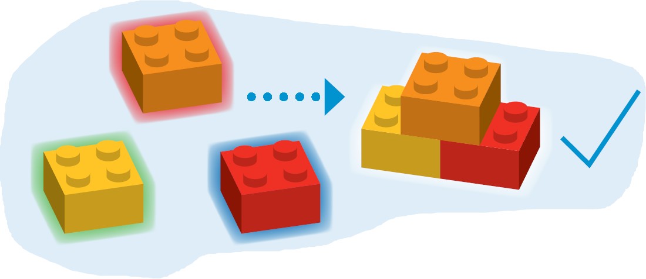
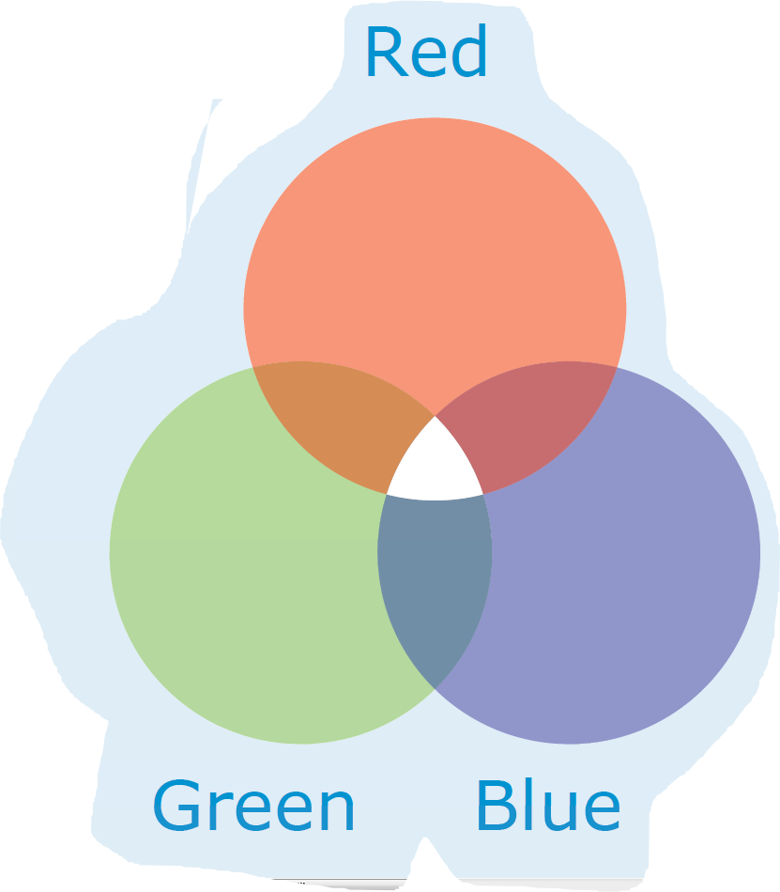
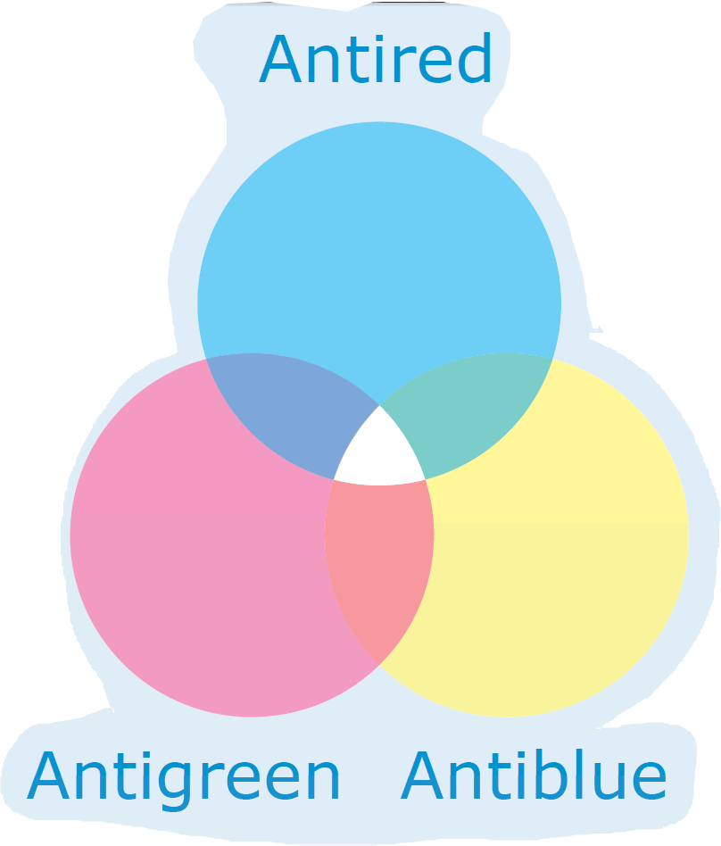



RULES FOR COMBINATION: COLOUR CHARGE
The colour charge of individual quarks have to “cancel out”. All particles must be “colour neutral”

Slide 7
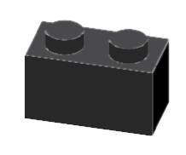


CONSERVATIONS
Particle interactions must obey certain rules, conserving certain numbers.
+
Electric charge
Baryon number
Lepton number
Strangeness

Slide 8
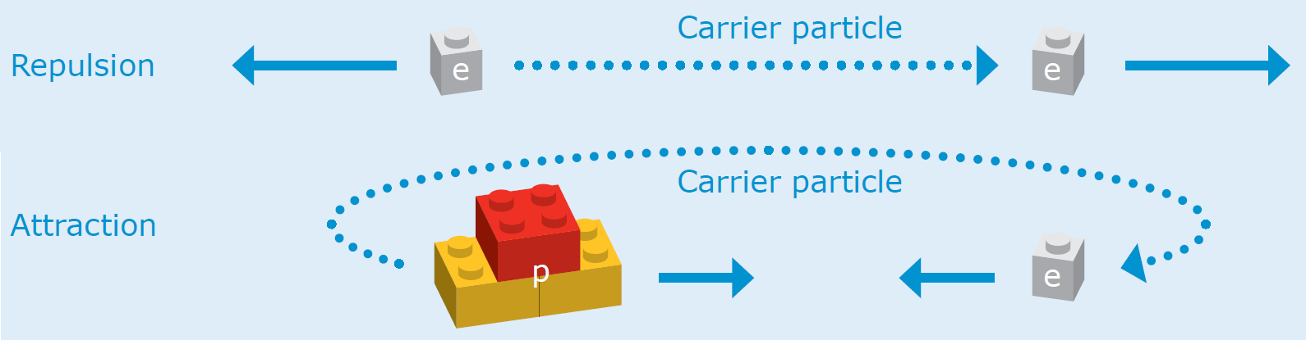
HOW FORCES WORK

Slide 9
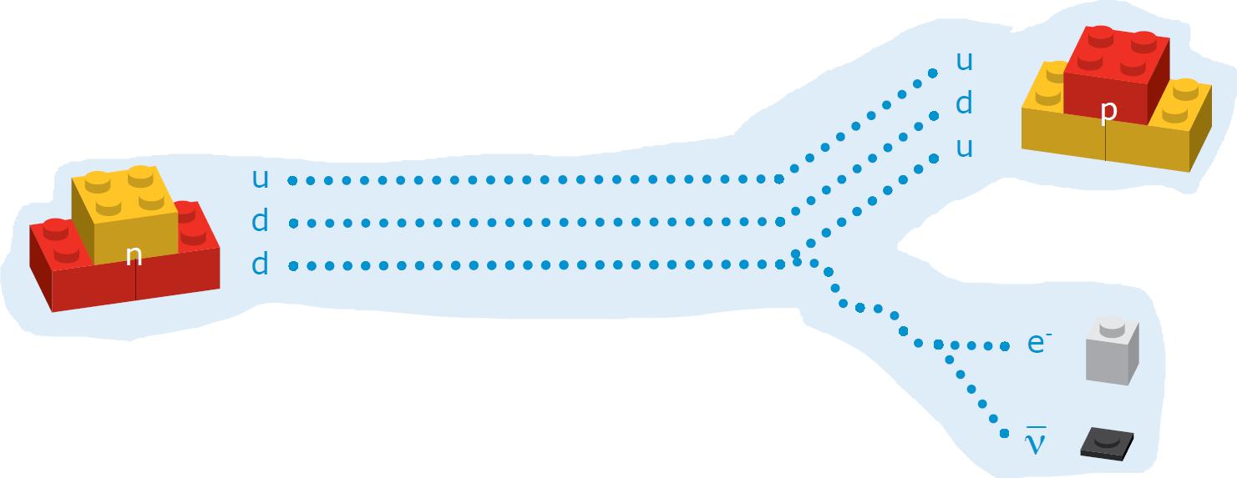
BETA DECAY

Slide 10
ROUNDUP
Quarks are amongst the smallest things in the universe
They combine to make baryons and mesons
Other particles called leptons aren’t made of quarks
Quarks combine according to certain rules (charge and colour)
Particle interactions conserve certain numbers and not others
Forces are carried through particles called bosons
Beta decay is governed by the weak force

