Slide 1


The Electromagnetic Spectrum
Notes:
Introduce Yourself
Get students to help draw the EM spectrum on board
Add in uses of the EM spectrum you’ve drawn
Land on COMMUNICATION
Ask for volunteer to draw a wave on the board
Go through concepts of amplitude, frequency and phase (they may not have done the latter)
Is there any information on this wave?
How do we use EM waves for communication then?

Slide 2

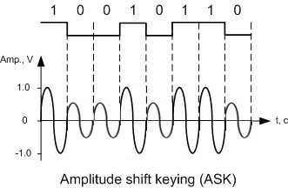
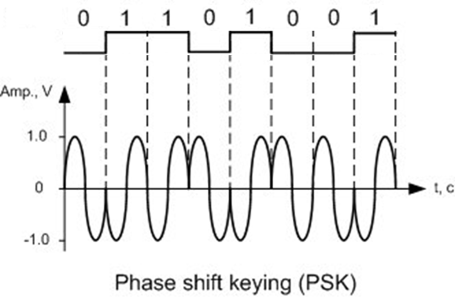
Shift Keying
(Modulation but for digital data)
T&M Atlantic
Notes:
Data is digital, conveyed in binary (zeros and ones) – the language computers talk etc.
We need to put that binary on a carrier wave, such as a radio wave, somehow
Here are two methods of doing that (introducing concepts of amplitude and phase on board and how we change them in the two methods)

Slide 3


Let’s play a game
Notes:
Introduce the game
Get into groups of at least 3

Slide 4
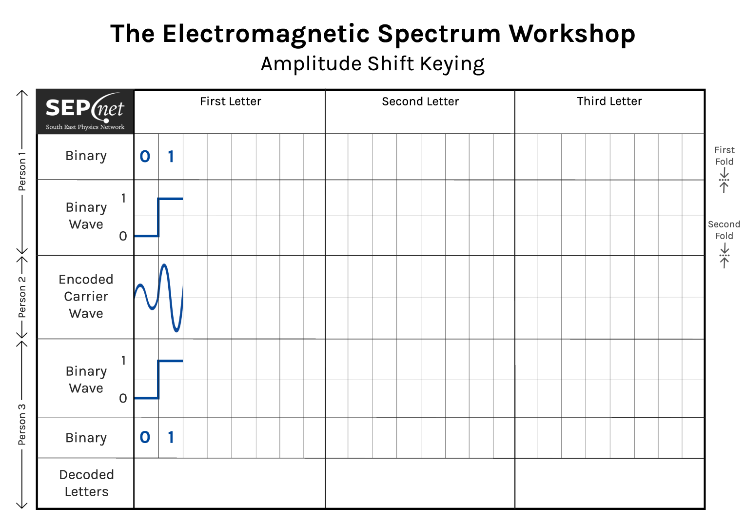

How to play the game
Current
Player
1 2 3
Notes:
Make it clear everyone plays at the same time
Three players: Person 1 (blue), Person 2 (green), and Person 3 (red)
Start with Person 1

Slide 5
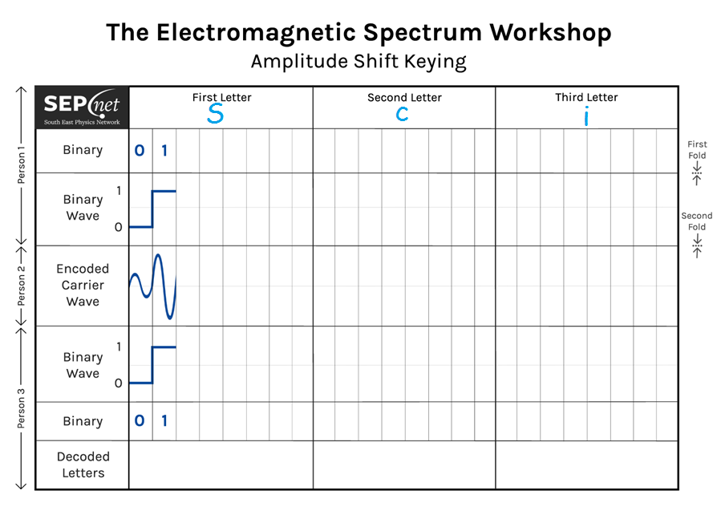
How to play the game
Current
Player
1 2 3
Notes:
Person 1 writes 3 letters. They can be capitals or lowercase. No numbers or symbols.

Slide 6
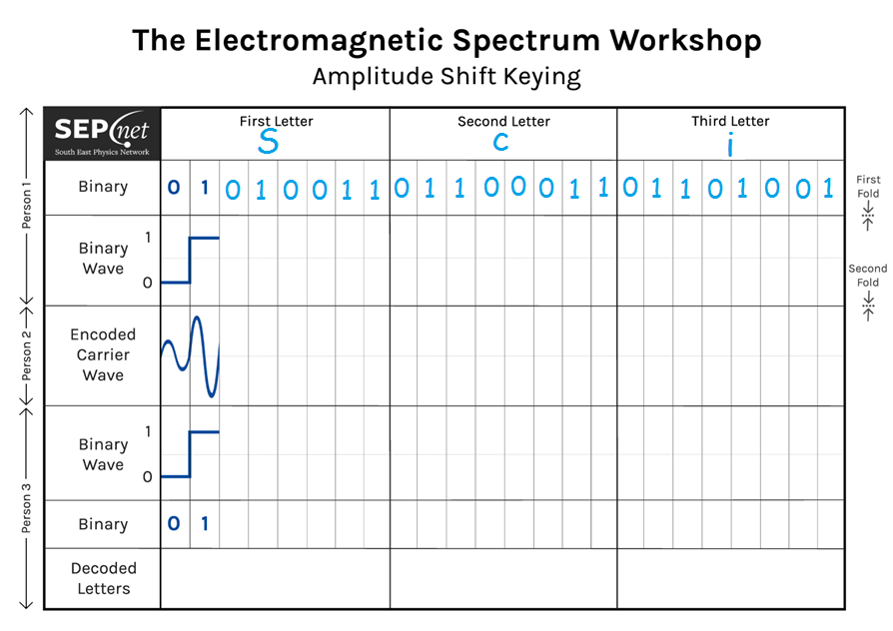
How to play the game
Current
Player
1 2 3
Notes:
Look up the binary (series of 0’s and 1’s) that corresponds to your three letters and write them in

Slide 7
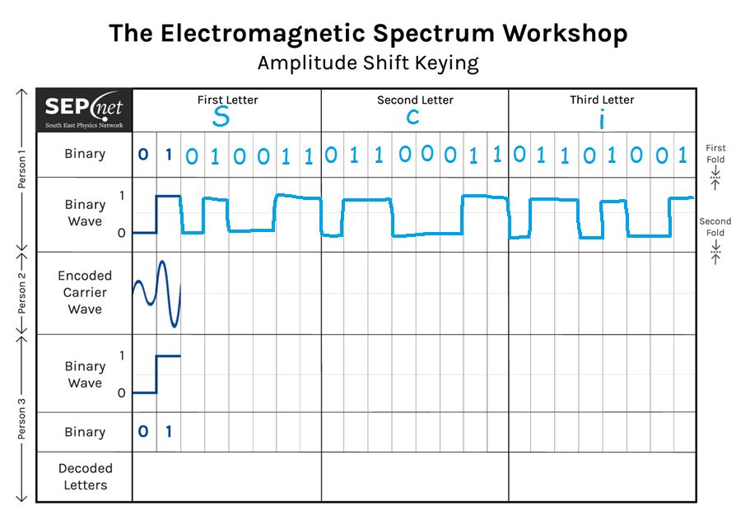
How to play the game
Current
Player
1 2 3
Notes:
Now draw the binary wave. Put horizontal lines in the upper box when the binary is 1 and in the lower box when 0. Connect these all up.

Slide 8
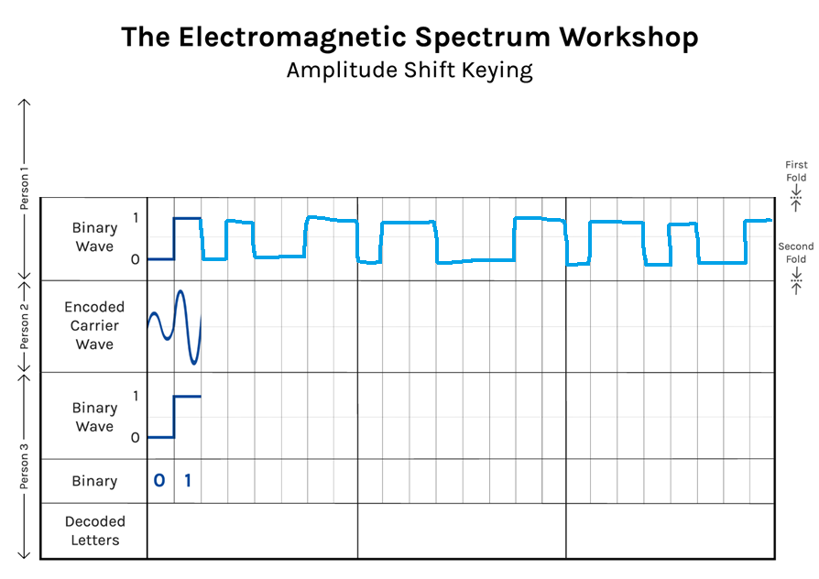
How to play the game
Current
Player
1 2 3
Notes:
Fold the paper over so only the binary wave is visible.

Slide 9
How to play the game
Current
Player
1 2 3
Notes:
And pass the paper over to Person 2.

Slide 10
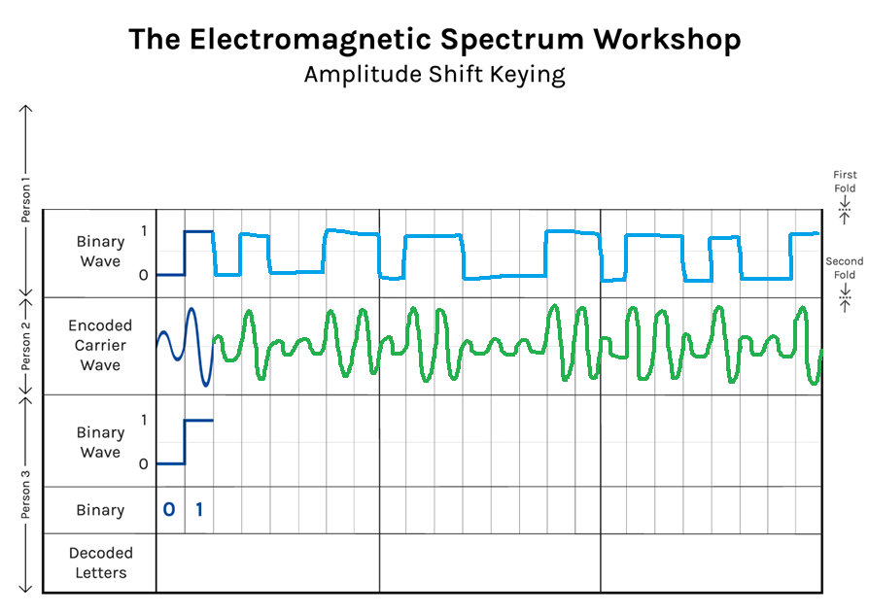
How to play the game
Current
Player
1 2 3
Notes:
Person two needs to encode the binary wave onto the carrier wave. In the case of Amplitude Shift Keying, draw a big sine wave in each box where there’s a 1 and a small sine wave where there’s a 0.

Slide 11
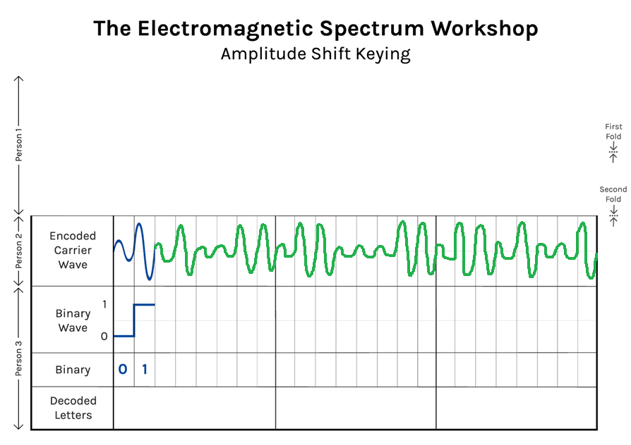
How to play the game
Current
Player
1 2 3
Notes:
Fold the sheet over so only the carrier wave is visible.

Slide 12
How to play the game
Current
Player
1 2 3
Notes:
Pass the sheet to Person 3.

Slide 13
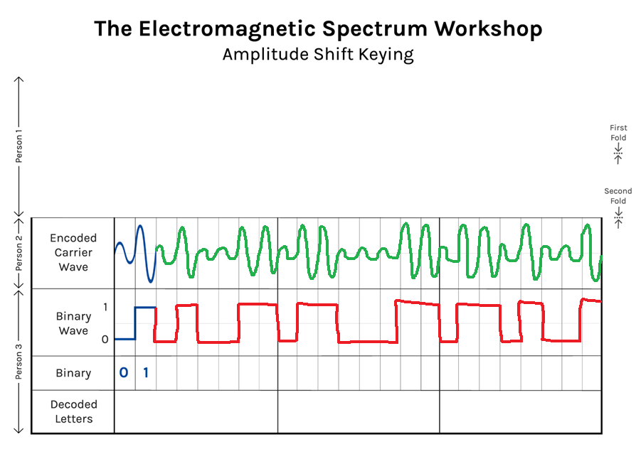
How to play the game
Current
Player
1 2 3
Notes:
Decode the wave to a binary wave, so put a horizontal line in the upper box where large amplitude sine waves are present and in the lower box for the small amplitude waves. Connect the lines together.

Slide 14
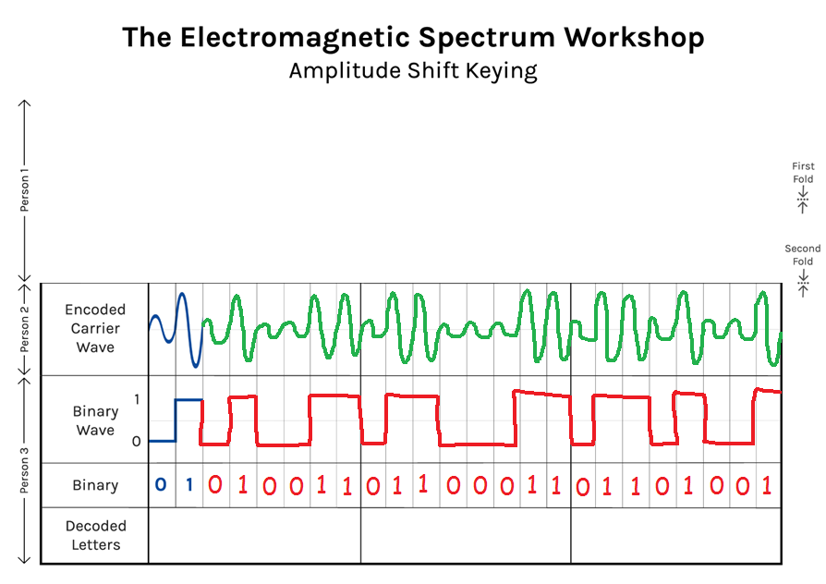
How to play the game
Current
Player
1 2 3
Notes:
Turn the binary wave into binary numbers: a series of 0’s and 1’s.

Slide 15

How to play the game
Current
Player
1 2 3
Notes:
Look up the binary to see if that corresponds to a letter. If it doesn’t put a question mark to indicate an error has occurred.

Slide 16
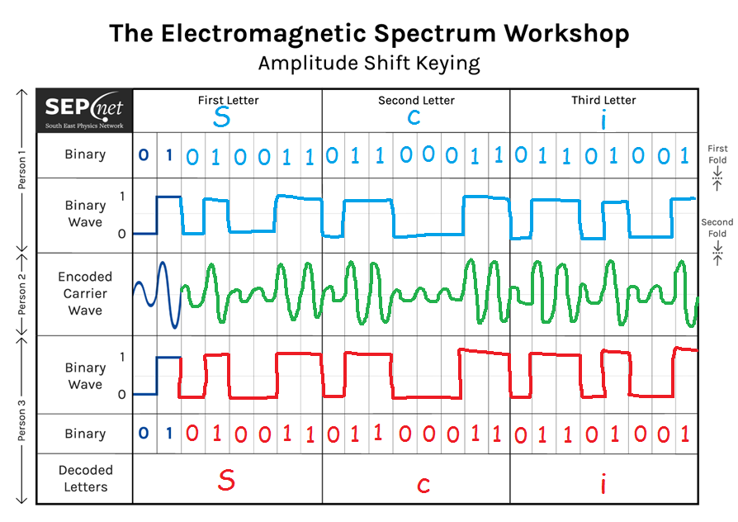
How to play the game
Current
Player
1 2 3
SUCCESS
Notes:
Unfold the paper and see if the message has successfully been communicated.

Slide 17
Shift Keying
(Modulation but for digital data)
What is the data rate in terms of the properties of the carrier wave?
How might we increase this without changing the carrier wave?
Notes:
Everyone do amplitude
Discuss the questions
If time have a go at phase too
Data rate here is the frequency of the carrier wave – each bit is one period. Usually have more than one period per bit (limits the number of different channels available to others) but always proportional to frequency. Fibre-broadband (visible light) quicker than 3 or 4G (microwaves) due to higher frequency and thus bandwidth

Slide 18
How to get more data?
More Levels
Amplitude & Phase
Notes:
Can use more levels than just two (4 amplitude levels shown on left)
Combine both amplitude and phase at the same time (two amplitude and two phase levels simultaneously on right)

Slide 19

How to get more data?
More Levels
Amplitude & Phase
Notes:
Or do more levels AND both methods – this is how wifi works

