Slide 1

Menopause
YOUR GP, YOUR HEALTH ALLY
Dr Olusegun Adetunji

Slide 2

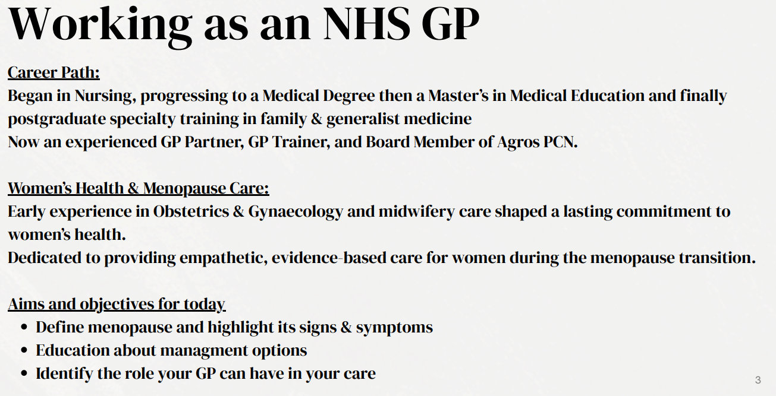

Slide 3
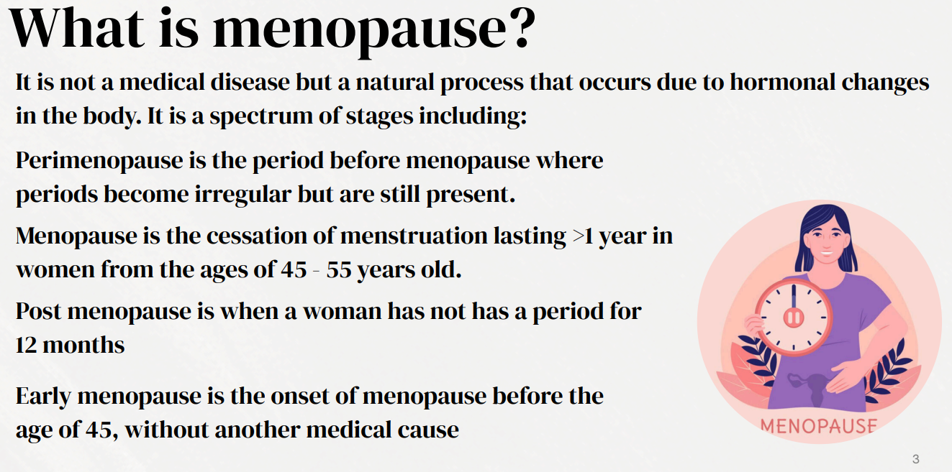

Slide 4
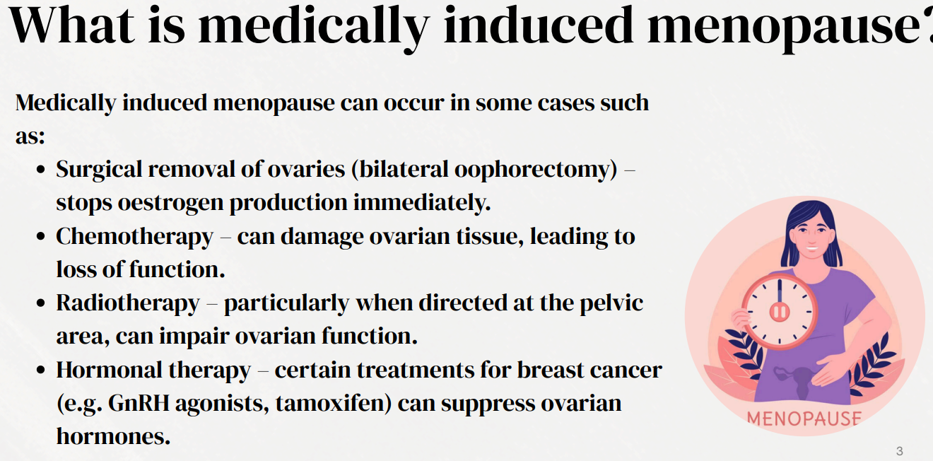

Slide 5
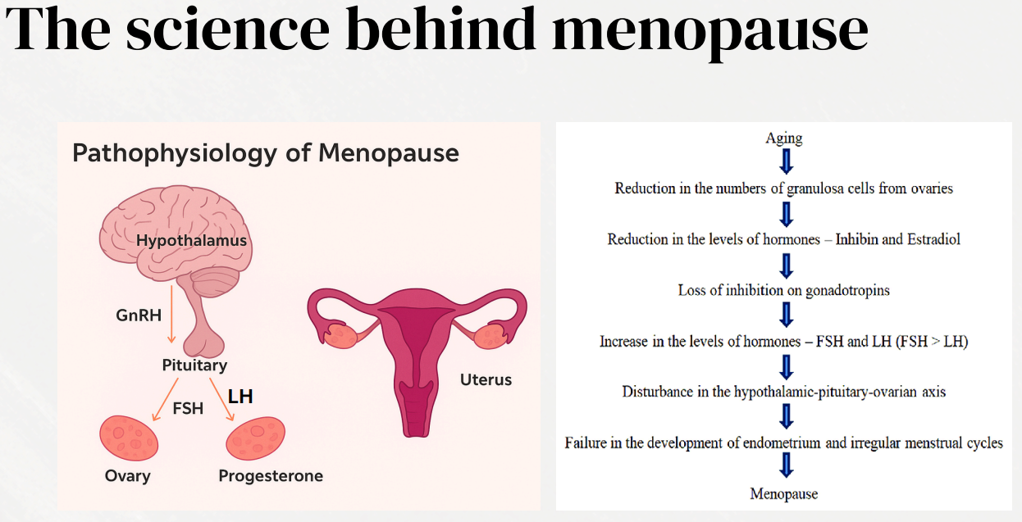

Slide 6
Changes in memory &
concentration
(brain fog)
Loss of libido
Weight gain
Hot flushes
Irregular periods
The more commonly known symptoms of menopause
Night sweats
Low mood & anxiety
Poor sleep
Frequent urination

Slide 7

Menopause & the workplace
Rigid working hours, poor ventilation & inflexible workload → exaggerated symptoms
Reduced self-confidence & professional self-image
Chronic fatigue → reduced productivity & efficiency
Poor sleep → irritability & reduced concentration

Slide 8


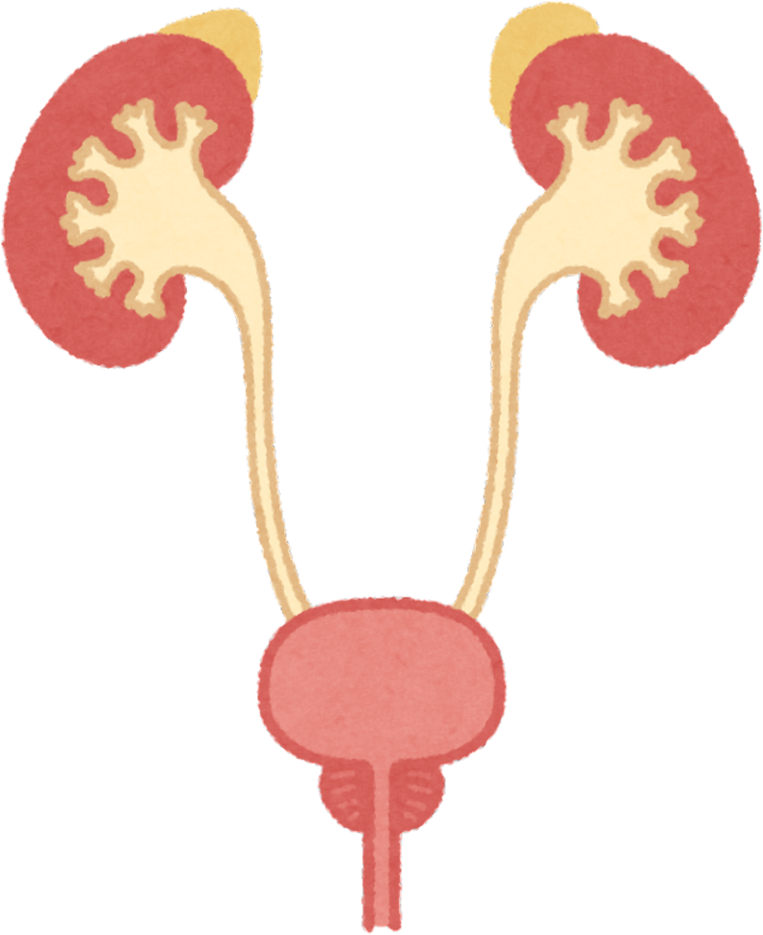
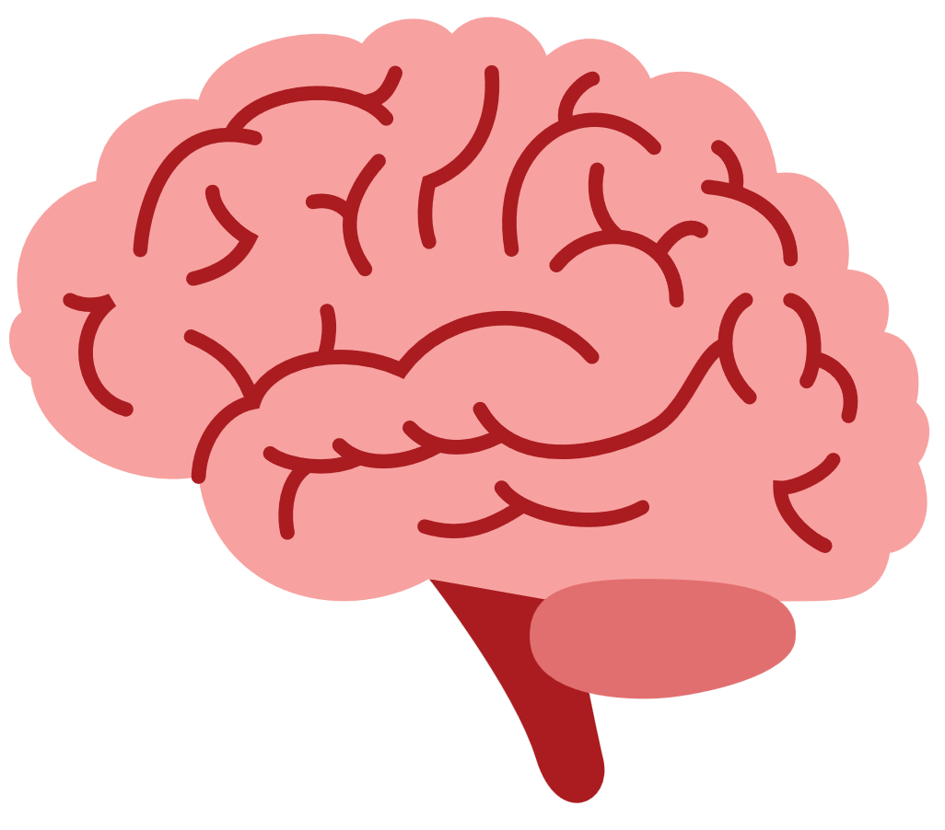

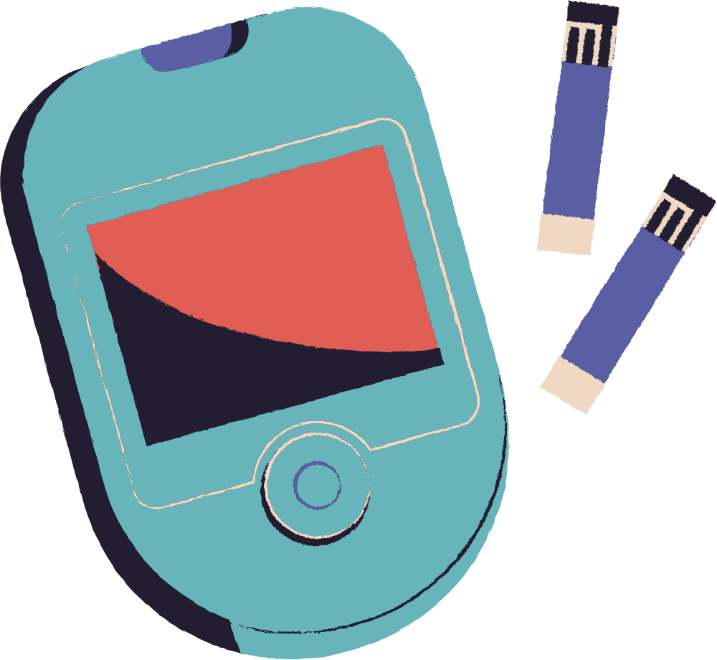
The complications of menopause
Increased risk of genitourinary symptoms
(50 - 75% of women experience this)
Reduced bone density
Increased risk of cardiovascular disease
Increaased risk of diabetes
Increased risk of cerebrovascular disease
Increased risk of psychogenic symptoms (70%)

Slide 9

Management
Hormonal treatment
  Tablets
  Patches & gel(transdermal)
  Vaginal creams, pessaries, rings
  Sprays
Non-hormonal treatment
  SSRI/SNRI
  Isoflavarone
  Black Cohosh
  St John’s Wort
  Elinzanetant / Fezolinetant (NK1/3 receptor antagonist used for hot flushes
Oestrogen only preparations are used for women without a uterus
Combined progesterone & oestrogen are used for women with a uterus
Menopause specific CBT
Lifestyle changes
  Breathable clothing
  Exercise
  Yoga
  Weight loss
  Stop smoking
The gold standard treatment is oestrogen based body identical transdermally for vasomotor symptoms but with micronised progesterone for women with a uterus

Slide 10
GP Appointment
You can:
  Prepare for your appointments by tracking your symptoms in a diary
  Prioritise your concerns when visiting the GP to allow the consultation to be beneficial as possible
  Request a double appointment
  Research your treatment options such as HRT
  Clearly communicate your goals and concerns
Your GP can:
  Prescribe HRT
  Discuss lifestyle factors
  Refer you to menopause services as appropriate
  Menopause focused CBT

Slide 11
Shared decision making
Symptoms severity
Dieticians
Gynaecologists
Approach to management
Multidisciplinary approach
Nurse
Consider personal health
GP
Physiotherapists
Lowest effective dose for the shortest necessary time

Slide 12
Useful resources
British menopause society
https://thebms.org.uk/
Menopause support UK
https://menopausesupport.co.uk/
NHS UK help & support menopause
https://www.nhs.uk/conditions/menopause/help-and-support/
Patient info
https://patient.info/womens-health/menopause

Slide 13
Any Questions?
THANK YOU FOR LISTENING
Dr Olusegun Adetunji

